Slide 1
DiceWars
Simon Christofzik, Olga Lapidus(Gruppe 3)

Slide 2
Simon Christofzik, Olga Lapidus(Gruppe 3)
DiceWars

Slide 3
Inhalt
Git
Scrum
Structure 101 (Architektur)
Sonar
Code Coverage(?)
Maven
Cost Estimation
Patterns
Dependency Injection
TUI Development
GUI Development

Slide 4
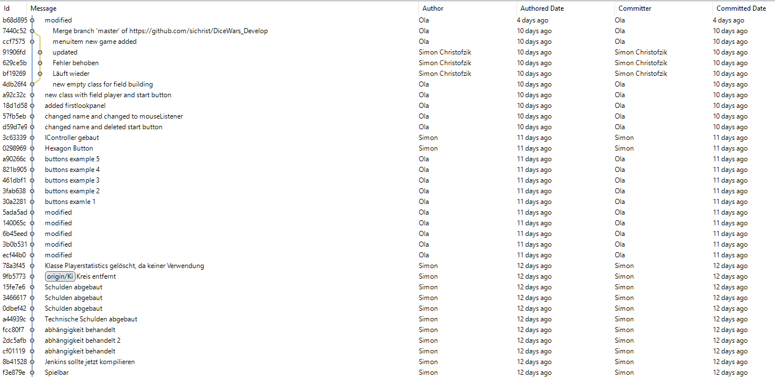
Git

Slide 5
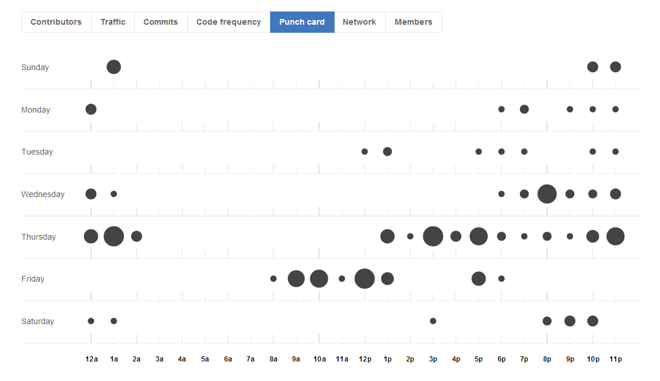
Git

Slide 6
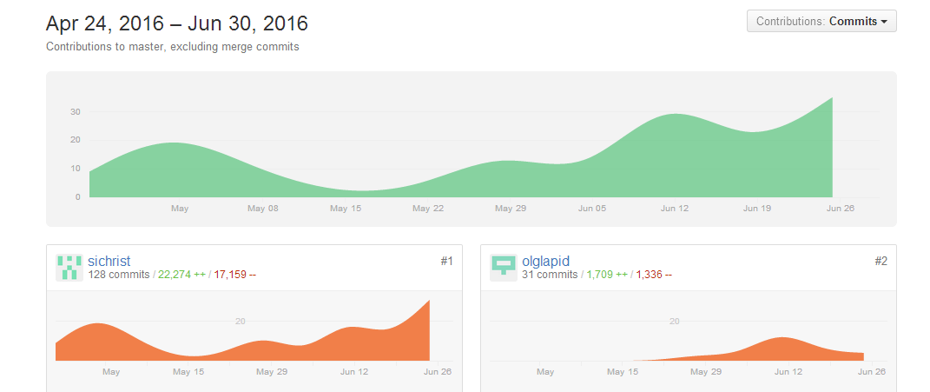
Git

Slide 7

Git

Slide 8
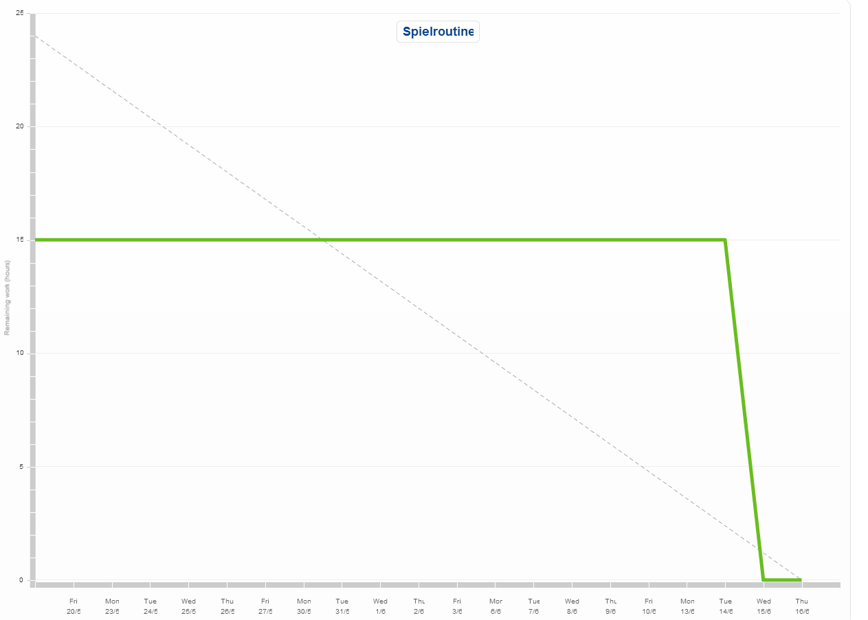
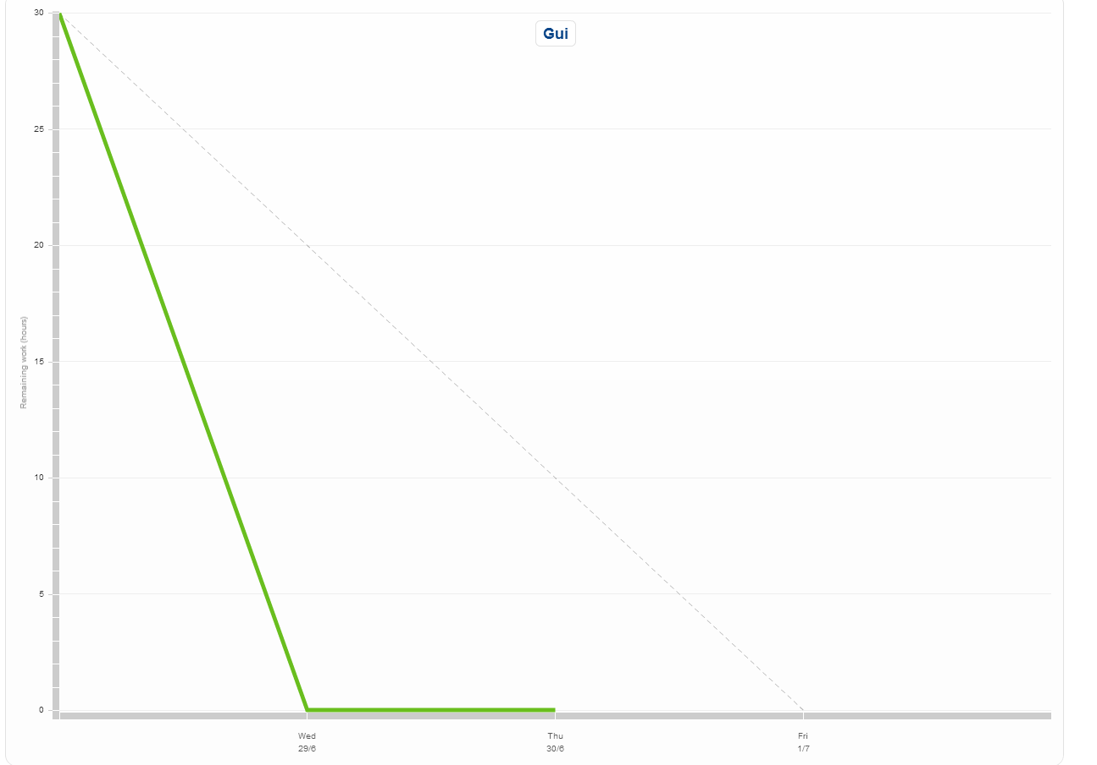
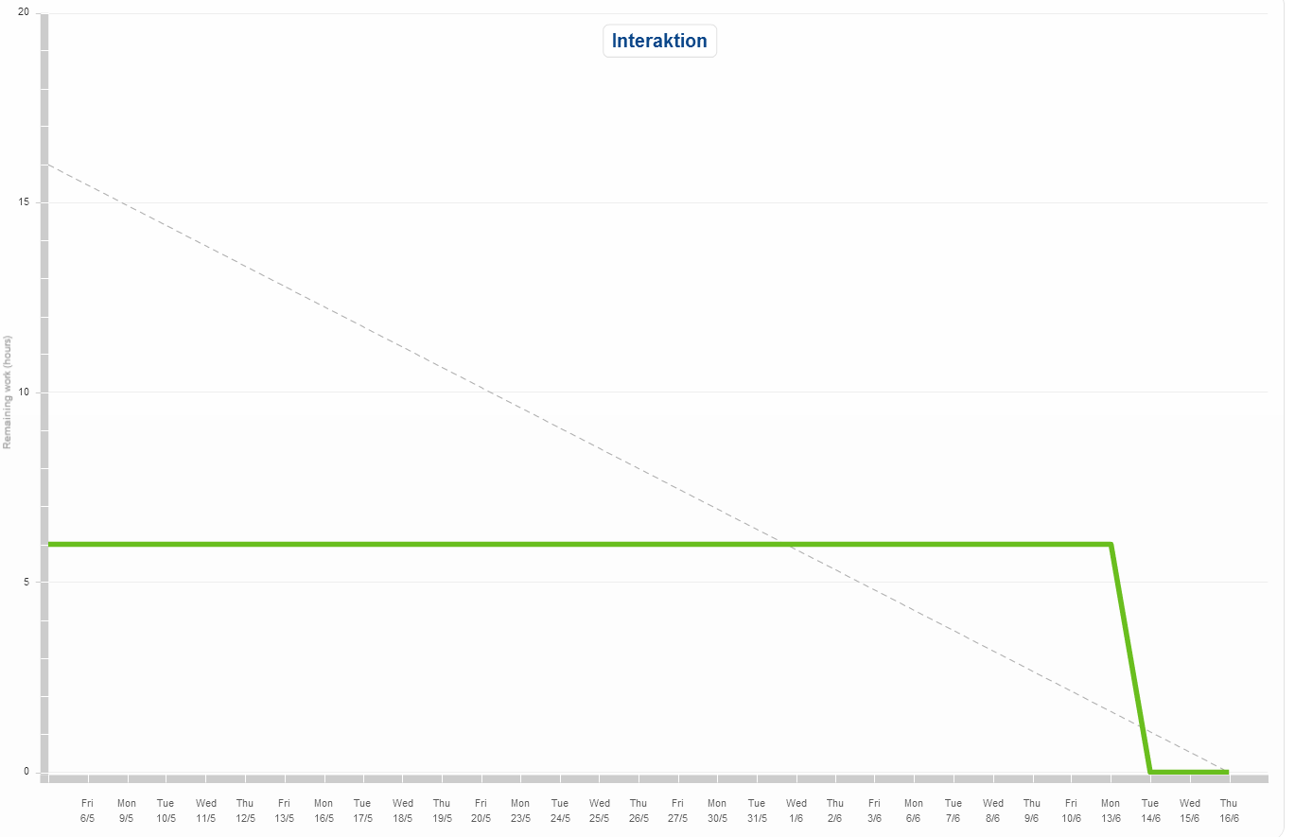
Scrum

Slide 9
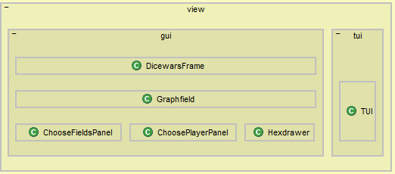
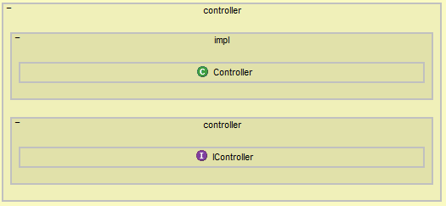
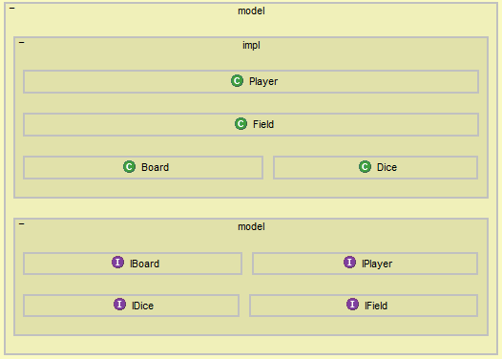
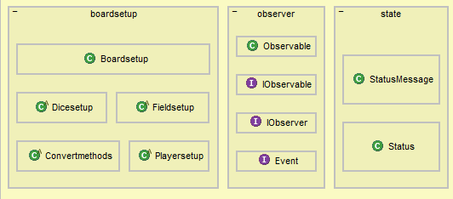
Structure 101, Architektur

Slide 10
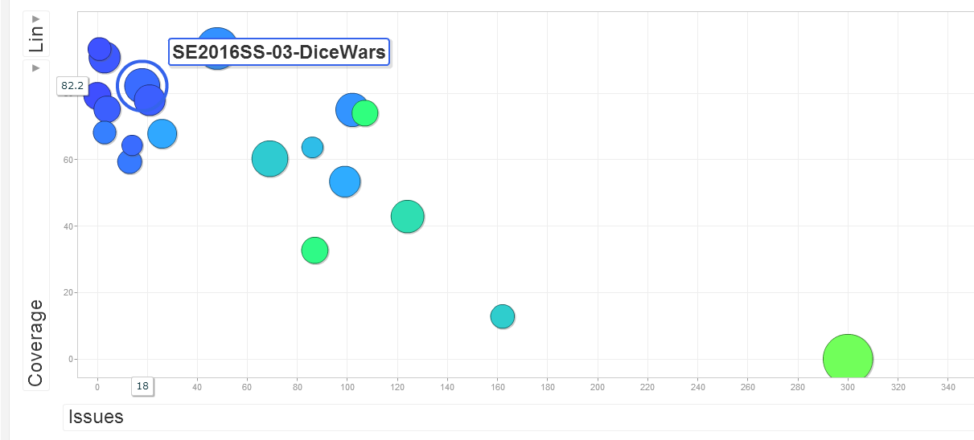
Sonar

Slide 11
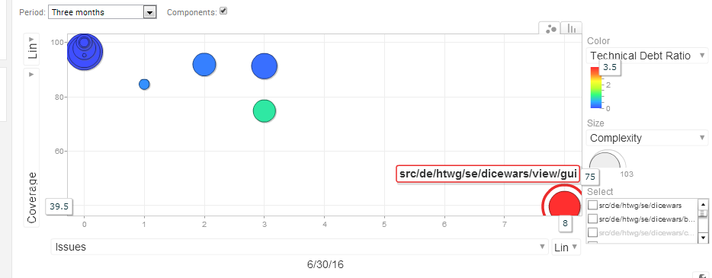
Sonar

Slide 12
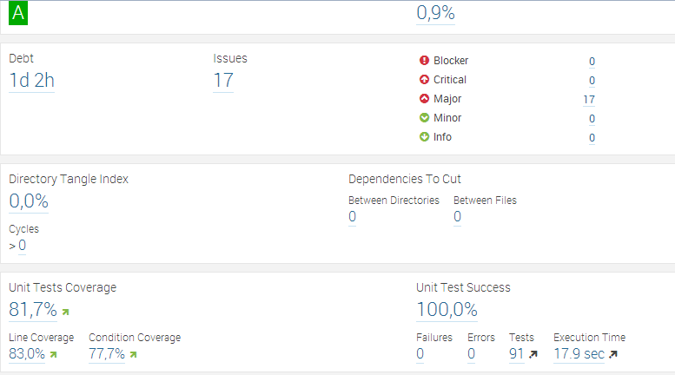
Sonar

Slide 13
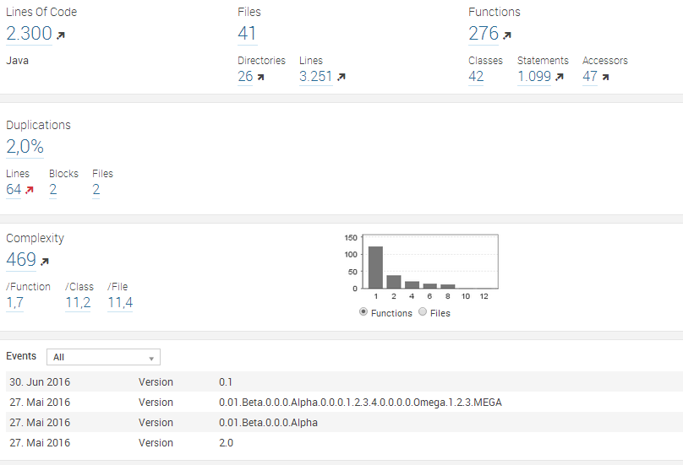
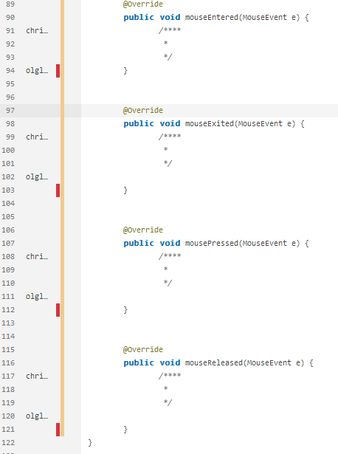
Sonar

Slide 14
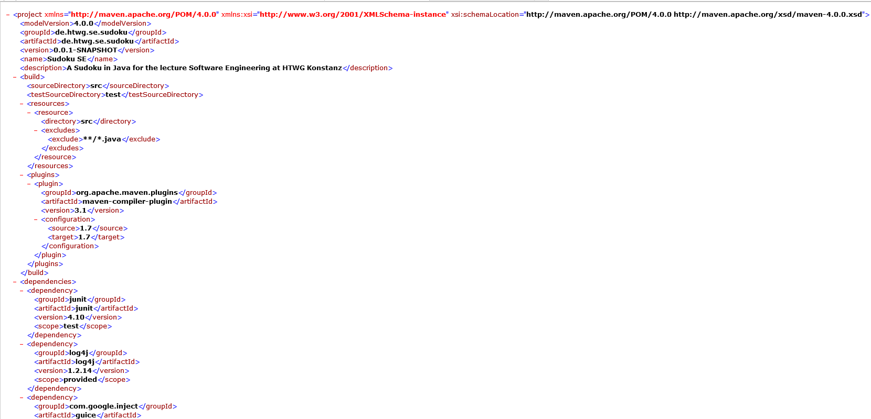
Pom

Slide 15


Cost Estimation

Slide 16
Patterns
Observer
Singleton
Strategy

Slide 17
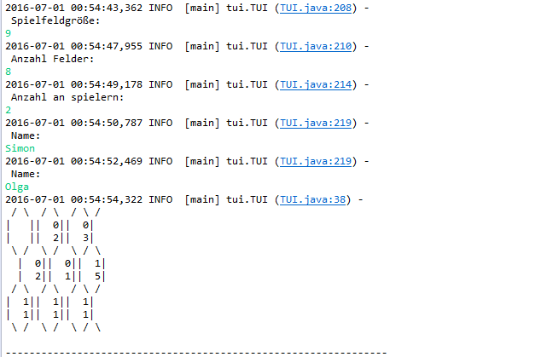
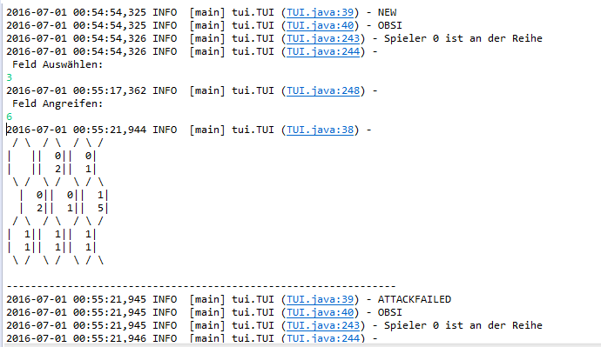
TUI Development

Slide 18
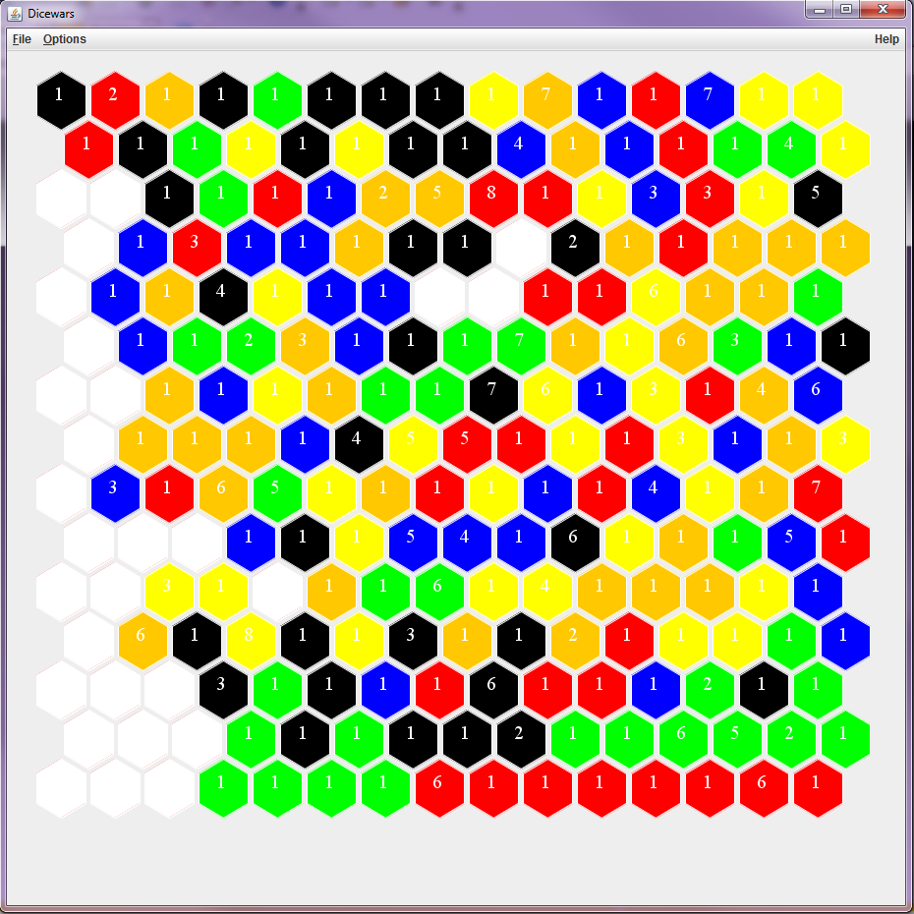
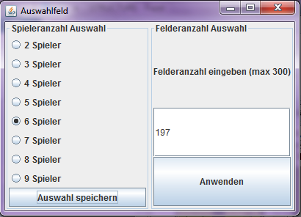
GUI Development

